Slide 1

Assessing how Different body shapes and sizes address the NFL’s 40-Yard Dash
Émile Therrien

Slide 2
Guiding Questions
Is there a suggested body determinant for an athlete’s speed and explosiveness?
Do body proportions determine players’ positions?
Body size (BMI)?
Other confounding factors?

Slide 3
variable choices and Data glimpse
Explanatory variables:
BMI
Generalized player position
Leg : torso ratio
Response variables:
Overall forty time as a metric the NFL uses for athlete speed
Ten-time split as a metric for an athlete’s explosiveness

Slide 4
variable choices and Data glimpse
Observations: 308
Each observation represents an athlete from the 2020 NFL combine
Variables: 8
Name, position, BMI, overall 40-yd dash time, 10-time split, leg : torso, generalized position
Generalized position assumes DL, OL, QB, WR, S, TE, LB, CB, and RB
“Generalized position” replaces “position” with more generality
E.g. “ILB”, “OLB”, “LB/SS” as “LB”

Slide 5
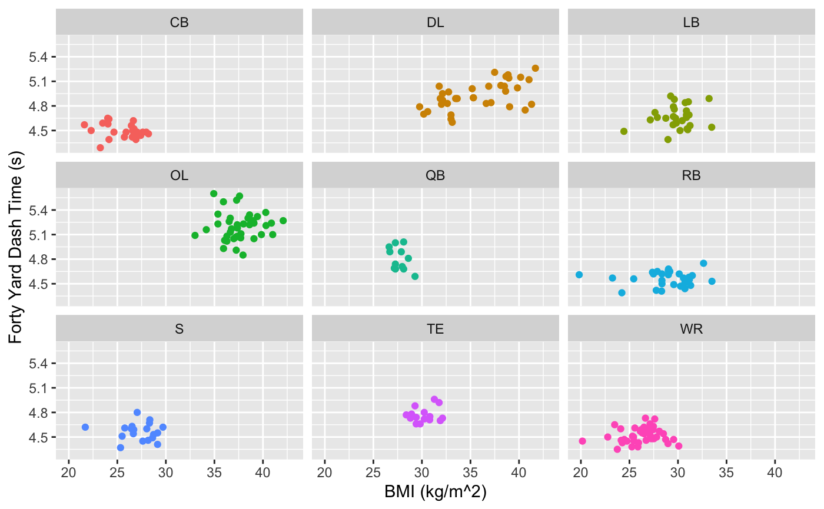
40-yd time versus BMI
Faceted by position
Data shows differences in BMI by position against 40-yd dash time
Do BMI and 40-time do have a strong (>0.5), positive correlation?
* Note “OL” and “DL”: relatively extreme BMI’s explored in “Further Questions”

Slide 6
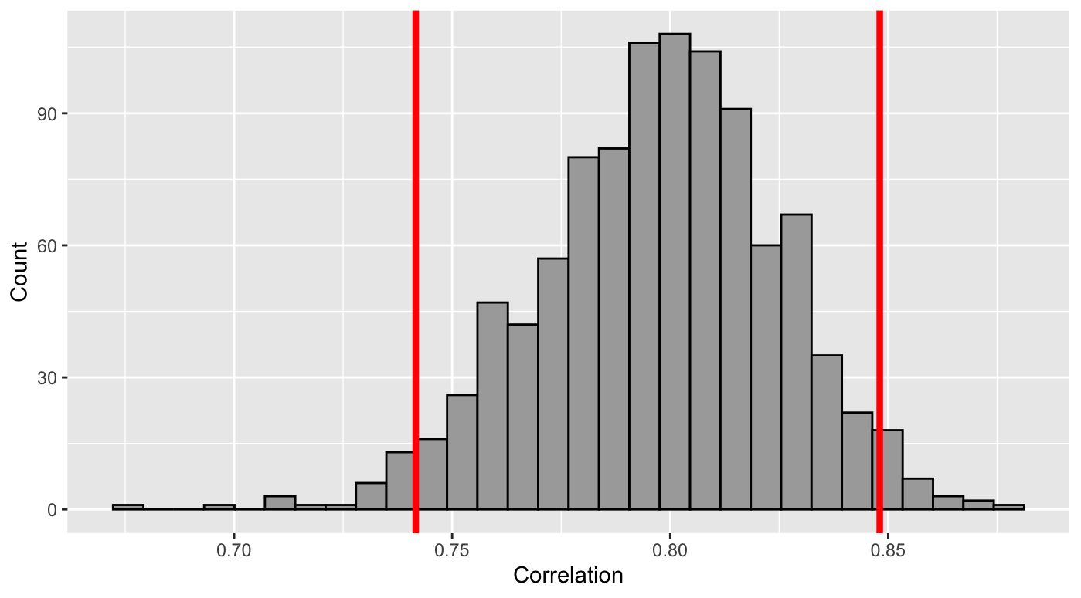
Do BMI and 40-time do have a strong (>0.5), positive correlation?
Based on an α level of 0.05, we are 95% confident that the true population coefficient for BMI and forty times is between (0.749, 0.844).
There is enough evidence to reject the null hypothesis that there is not a strong, positive correlation (≤ 0.50) between BMI and forty time.

Slide 7
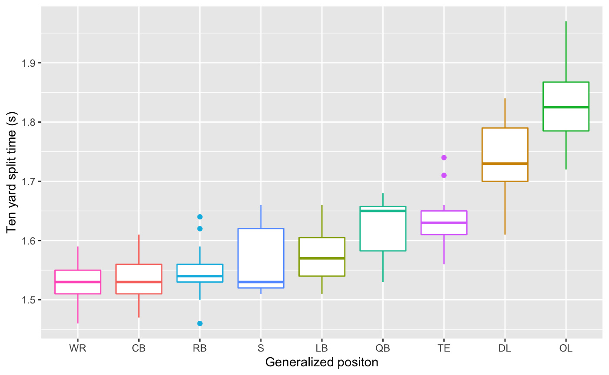
10-time split versus Generalized position
Ordered by mean ten-time split
Data shows differences in the first 10-yd split by position.
Does position effect explosiveness?
Can we model 10—time splits based on position?

Slide 8
What is the relationship between 10—time split and position?
Predicted 10-time splits:
1.533 (CB)
1.536 (WR)
1.545 (RB)
1.561 (S)
1.573 (LB)
1.621 (QB)
1.634 (TE)
1.739 (DL)
1.827 (OL)
All qualifying conditions were met for linear model inference:
The variables were independent of each other
Augmented data points had equal variance and linearity
Augmented data was normally distributed
See appendix

Slide 9
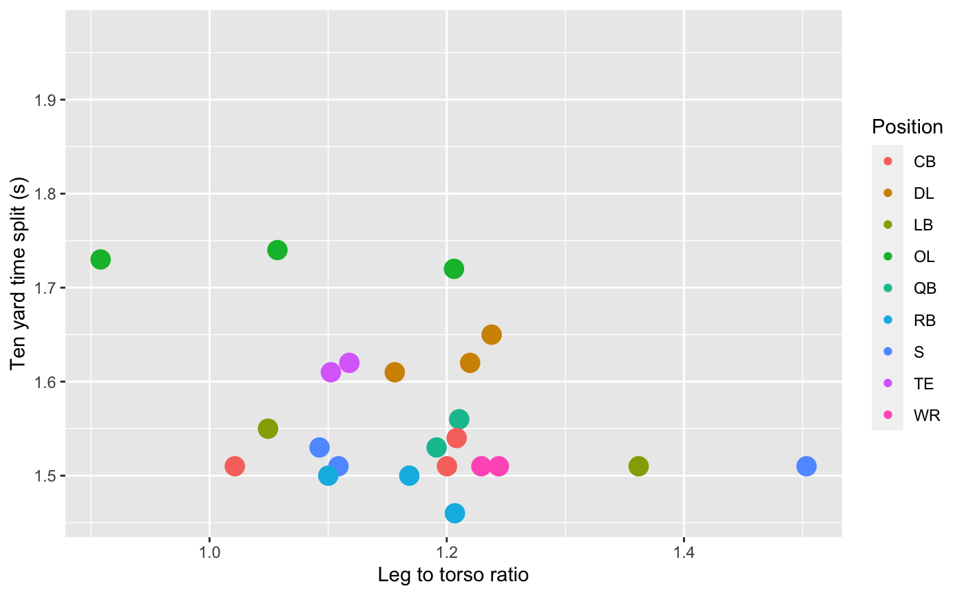
10-time split versus Leg : Torso ratio
Colored by position
Data shows differences in leg to torso ratio versus 10–time split.
Are leg : torso ratios and the first ten-yard splits correlated with each other?

Slide 10
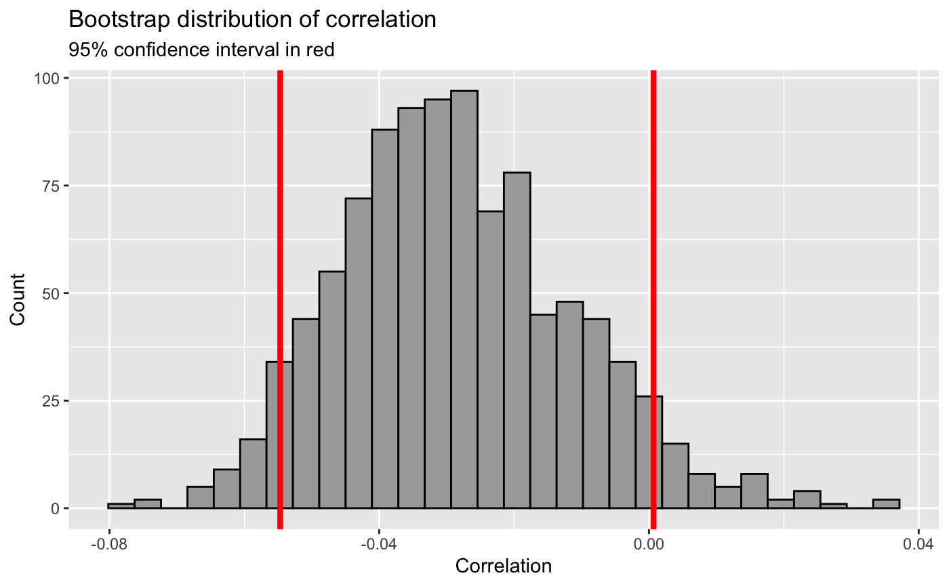
What is the relationship between leg : torso ratio and the first ten-yard splits?
Based on an α level of 0.05, we are 95% confident that the true population coefficient for leg : torso and ten-time splits is between (-0.055, 0.001).
The evidence fails to reject the null hypothesis that there is no correlation between leg : torso ratio and ten-time splits

Slide 11
Conclusions
BMI has a strong association on how fast the 40-yd dash is completed
Leg : torso ratio, however, had no significant association with how fast the first 10-yard splits were run
---------
Body size has strong association with 40-yard dash times (speed)
Failed to find significant association between body proportions and 10-yard dash times (explosiveness)

Slide 12
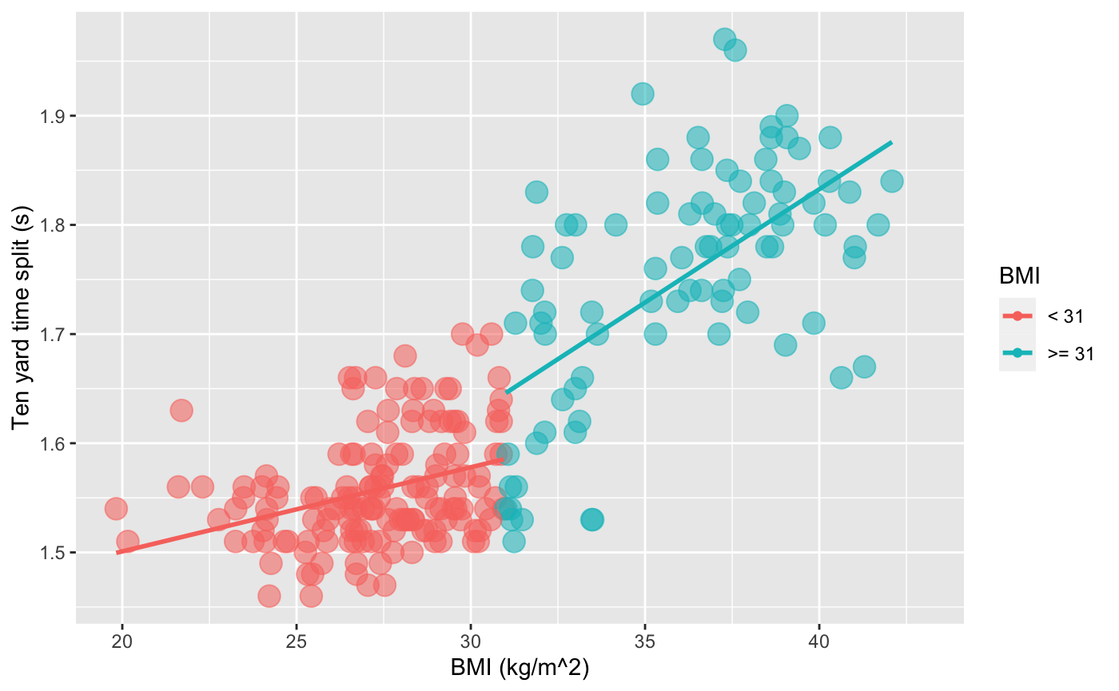
Further questions
Is there a BMI cutoff where 10-time splits are extremely, adversely effected?
What are better ways to represent body proportionality between athletes?
I.e. mass of legs relative to whole body, leg circumferences, and leg densities
Are players in certain positions based on their body size and shape?
Is position an explanatory variable for how fast the 40-yard dash is ran?

Slide 13
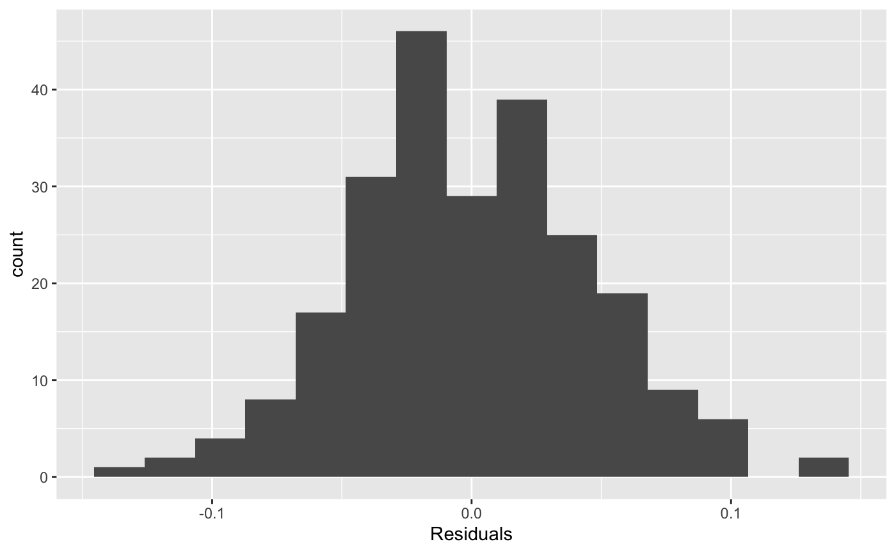
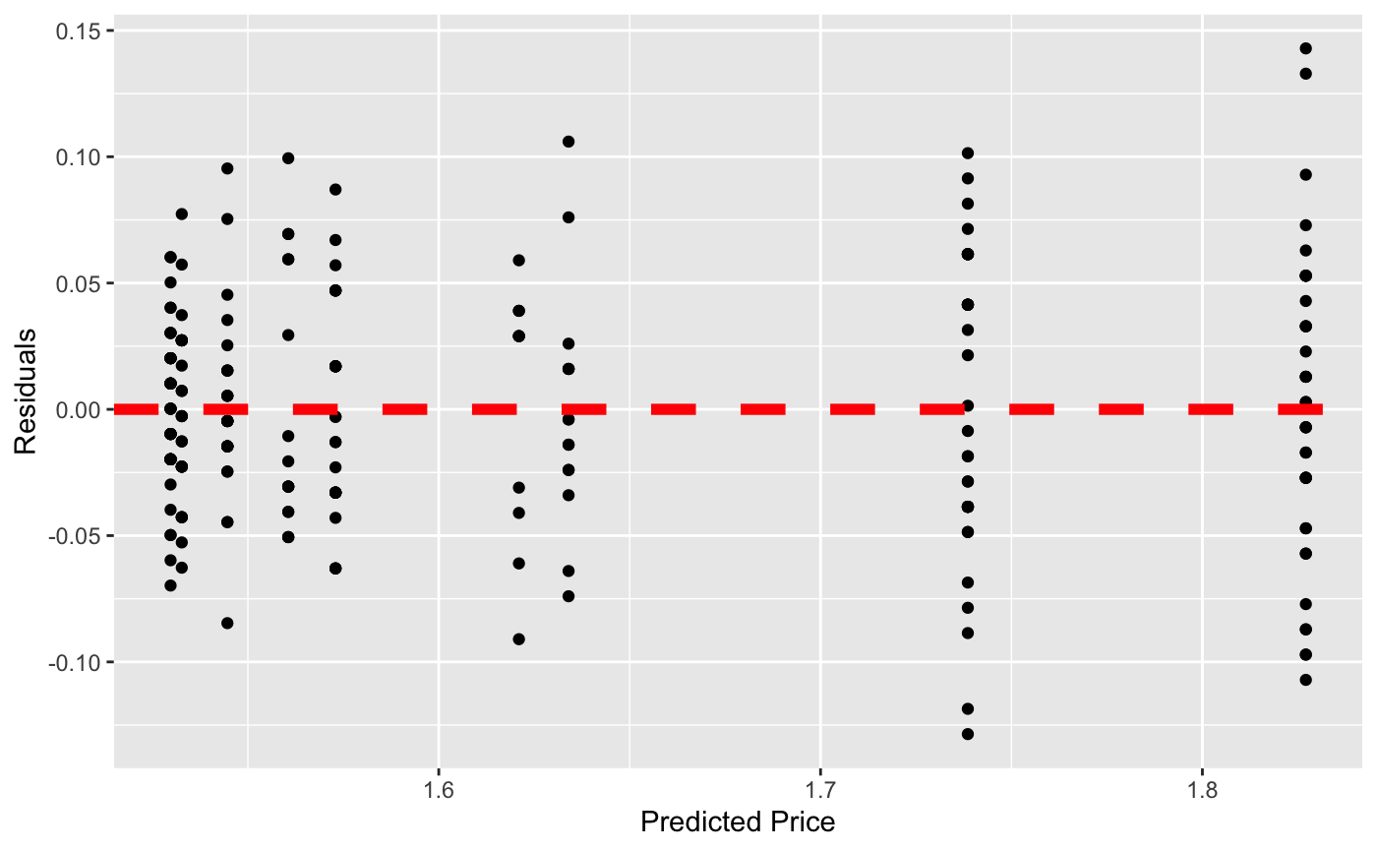
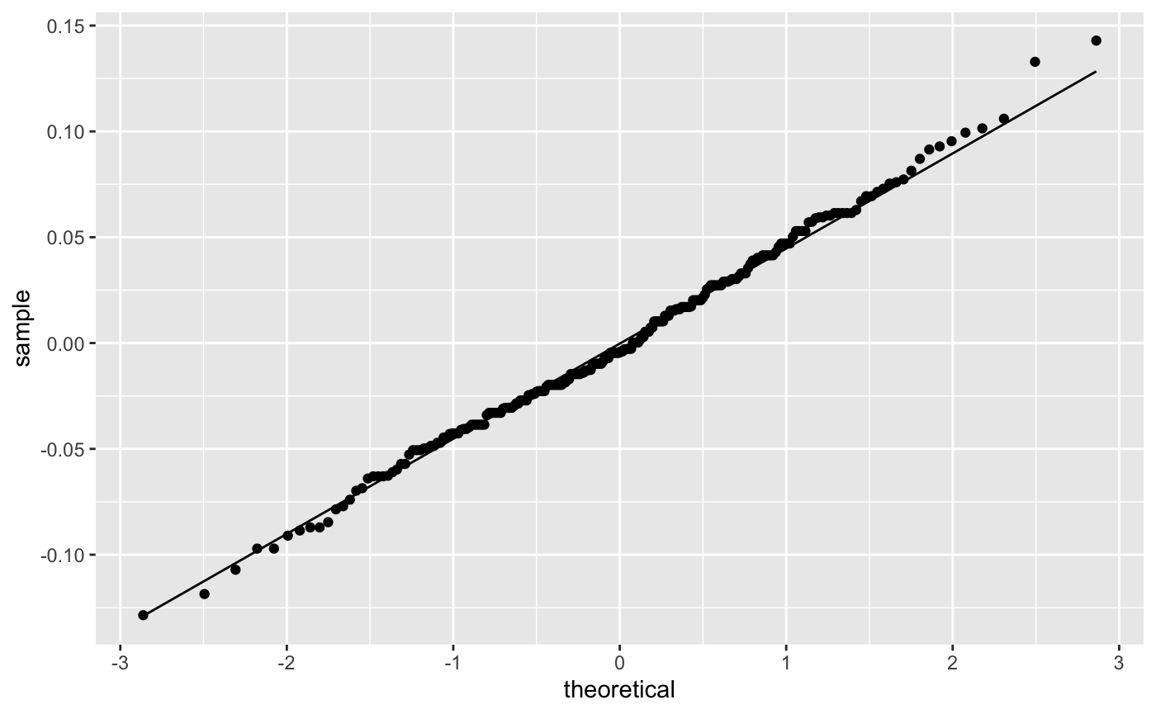
Appendix
Normally distributed
histogram
Equal variance and linearity
Normally distributed q-q plot

